Slide 1
A Design and Development of a Database Driven Web and Mobile Application

Slide 2
PROBLEM STATEMENT
This project will improve the services of the Chocolate-IN restaurant by making booking service online through an online reservation system. This will eliminate the time taken in queues by customers and save on resources such as extra expenditure incurred in hiring new employees to cater for increasing number of customers.

Slide 3
REQUIREMENTS
User Requiremnts
User should be able to sign in,sign out and log in of the system
User should be able to make reservations
User should be able to select the number of guest that will be present at a table
User should be able to select time and date

Slide 4
System Requirements
OS: Windows 7 with SP1; Recommended: Windows 10
CPU: Intel or AMD processor with 64-bit support; Recommended: 2.8 GHz or faster processor
GPU: nVidia GeForce GTX 1050 or equivalent; Recommended: nVidia GeForce GTX 1660 or Quadro T1000
Disk Storage: 4 GB of free disk space
Monitor Resolution: 1280x800; Recommended: 1920x1080
Internet: Internet connection required for software activation making new reservations.
Languages used; PHP,JavaScript,HTML and CSS
A web hosting site
Database:MySQL

Slide 5
SOFTWARE PROCESS
The software process used here is the agile method. This way the system can be updated
SOFTWARE MODELLING
The agile model is used here, it allows the designer to make changes which also adds value to the system.

Slide 6
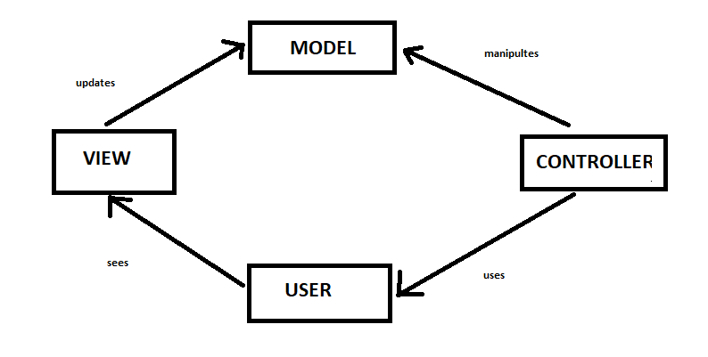
SOFTWARE ARCHITECTURE
The model-view-controller design pattern was used here;
Figure 1MVC sofftware design pattern of the Choclolate-In restaurant

Slide 7
DESIGN AND IMPLEMENTATION
After the purpose and specifications of software are determined, software developer designs or develop a plan for a solution. The Software designer put solution to the problem in hand using the available capabilities.

Slide 8
TESTING
Software testing can be stated as the process of validating and verifying that a software application: 1.meets the requirements that guided its design and development 2.works as expected 3.Can be implemented with the same characteristics.

Slide 9
Planning
Software designer develops a procedure or plan to analyze the total size of the project, that is the resources or everything that was used in the development of the project

Slide 10
Costing
Cost estimation in project management is the process of forecasting the cost and other resources needed to complete a project within a defined scope.The software makes an estimation which accounts for each element required for the project and calculates a total amount that determines a project’s budget

Slide 11
scheduling
This is the time within which the project operates.A schedule also usually includes a planned start and finish date, duration and resources assiigned to each activity.

